Slide 1
Unit 7: Recursion

Slide 2
CONTENTS
Introduction
Principle of Recursion
Recursion vs. Iteration
Recursion Example: TOH and Fibonacci Series
Applications of Recursion
Search Tree

Slide 3
Recursion
Recursion is a process by which a function calls itself repeatedly, until some specified condition is satisfied
The process is used for repetitive computations in which each action is stated in terms of a previous result.
To solve a problem recursively, two conditions must be satisfied.
First, the problem must be written in a recursive form
Second the problem statement must include a stopping condition

Slide 4
Recursion Vs Iteration
Recursion and iteration both repeatedly executes the set of instructions
Recursion is when a statement in a function calls itself repeatedly
The iteration is when a loop repeatedly executes until the controlling condition becomes false.
The primary difference between recursion and iteration is that a recursion is a process always applied to a function.
The iteration is applied to the set of instructions which we want to get repeatedly executed.

Slide 5
Comparison
Property | Recursion | Iteration
Definition | Function calls itself. | A set of instructions repeatedly executed.
Application | For functions. | For loops.
Termination | Through base case, where there will be no function call. | When the termination condition for the iterator ceases to be satisfied.
Usage | Used when code size needs to be small, and time complexity is not an issue. | Used when time complexity needs to be balanced against an expanded code size.
Code Size | Smaller code size | Larger Code Size.
Time Complexity | Very high (generally exponential) time complexity. | Relatively lower time complexity (generally polynomial-logarithmic).

Slide 6
Iterative Vs Recursive computing N!

Slide 7
Factorial of an integer number using recursive function
#include <stdio.h>
int factorial(int);
int main() {
int n;
int fact;
printf("Enter a number: ");
scanf("%d", &n);
fact = factorial(n);
printf("%d! = %d\n", n, fact);
return 0;
}
int factorial(int n) {
if (n == 0) {
return 1;
} else {
return n * factorial(n - 1);
}
}
Factorial(5)=
5*Factorial(4)=
5*(4*Factorial(3))= 5*(4*(3*Factorial(2)))=
5*(4*(3*(2*Factorial(1))))=
5*(4*(3*(2*(1*Factorial(0)))))=
5*(4*(3*(2*(1*1))))=
5*(4*(3*(2*1)))=
5*(4*(3*2))=
5*(4*6)=
5*24=
120

Slide 8
Recursion Pros and Cons
Pros
•The code may be much easier to write.
•To solve some problems which are naturally recursive such as tower of Hanoi.
Cons
•Recursive functions are generally slower than non-recursive functions.
•May require a lot of memory to hold intermediate results on the system stack.
•It is difficult to think recursively so one must be very careful when writing recursive functions.

Slide 9
Tower of Hanoi Problem

Slide 10
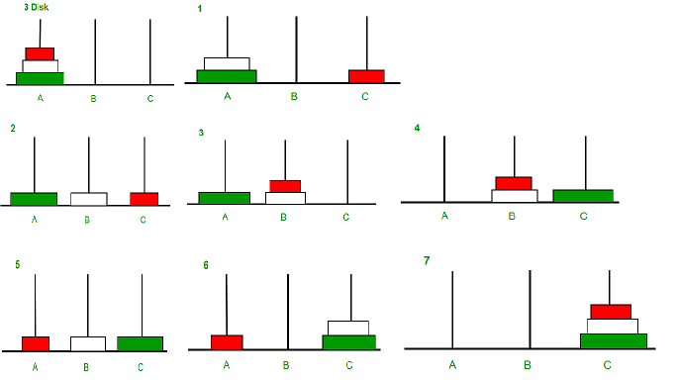
TOH

Slide 11
Tower of Hanoi Problem
The mission is to move all the disks to some another tower without
violating the sequence of arrangement.
The below mentioned are few rules which are to be followed for tower
of Hanoi
Only one disk can be moved among the towers at any given time.
Only the "top" disk can be removed.
No large disk can sit over a small disk.

Slide 12
Objective of TOH problem
Transfer the disks from the left most pole to the rightmost pole
without ever placing a larger disk on top of a smaller disk.
Only one may be moved at a time and each disk must always be placed
around one of the poles.
The problem can be solved in recursive method in three steps.
Move the top n-1 disks from the left pole to the center pole
Move nth disk(largest) to the right
Move the n-1 disk on the center pole to the right pole

Slide 13
C-program
/*C program for Tower of Hanoi using Recursion */
#include<stdio.h>
void towers(int, char, char, char);
intmain()
{
Int num;
printf("Enter the number of disks :");
scanf("%d",&num);
printf("The sequence of moves involved in the Tower of Hanoi are:\n");
towers(num, 'A', 'C','B'); return0;
}
void towers(int num, char frompeg, char topeg, charauxpeg)
{
if (num ==1)
{
printf("Move disk 1 from peg %c to peg %c\n", frompeg,topeg);
return;
}
towers(num -1, frompeg, auxpeg, topeg); printf("Move disk %d from peg %c to peg%c\n",num, frompeg, topeg);
towers(num -1, auxpeg, topeg,frompeg);
}

Slide 14
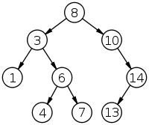
Binary search
BSTNode *Binsearch(struct BSTNode *root, int key)
{
If( root==NULL)
return NULL;
else if(key==root->info)
return root;
Else if (key<root->info)
return BinSearch(root->left, key);
Else
return BinSearch(root-> right, key);

